Slide 1
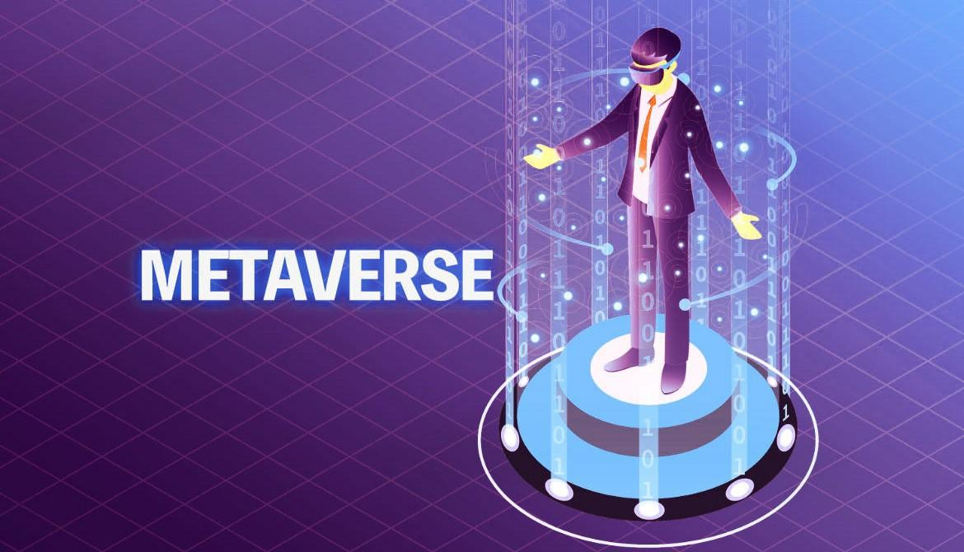
MUHAMMAD HASSAN FAROOQ

Slide 2

What Is METAVESE?
A Brief History Of Future
Confusion And Uncertanity
Definition
The Next Internet

Slide 3
A brief History Of Internet
Science fiction writer Neal Stephenson coined the term “Metaverse” in his 1992 novel Snow Crash, where humans, as avatars, interact with each other and software agents, in a three-dimensional virtual space that uses the metaphor of the real world.
Snow Crash is set at some point in the early 21st century, years after a global economic collapse. Most layers of government have been replaced by for-profit “Franchise-Organized Quasi-National Enti ties” and “burbclaves,” a contraction of the term “suburban enclaves.

Slide 4
Conversations with Stephenson helped inspire Jeff Bezos to found the private aerospace manufacturer and suborbital spaceflight company Blue Origin in 2000, with the author working there part-time until 2006, when he became a senior advisor to the company (a position he still holds). As of 2021, Blue Origin is considered the second most valuable company of its kind, ranked only behind Elon Musk’s SpaceX.
Second life , is the online virtual world , developed by Philip Rosedale and his team at Linden Lab in 2003. It was very much a precursor to the Metaverse worlds being developed today. Second Life has an active user base of a million people, each spending over four hours a day in this virtual world

Slide 5
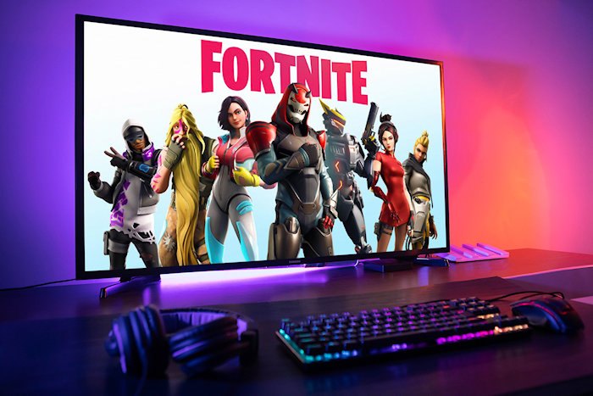
Fortnite (2017) video game was a huge success upon its release, and it introduced many people to the look and feel of the Metaverse and Cryptocurrency. Fortnite user base totals 350 million.

Slide 6
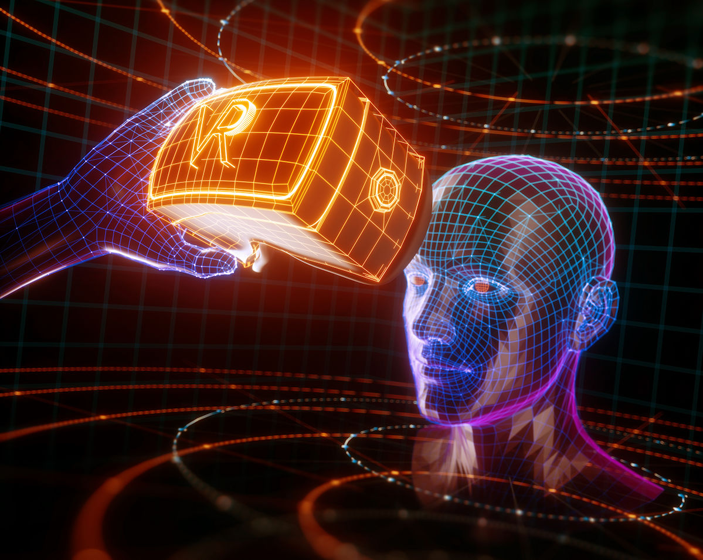
The Evolution of various kind of Technology and new Features in the METAVERSE over the last few years has been incredible but not as amazing as it will beyond 2021

Slide 7
CONFUSION AND UNCERTANITY
The term Metaverse has no consensus definition or consistent description. Most industry leaders define it in the manner that fit their own world views and the capability of their company
AS MICROSOFT SAID “The ability to bridge the digital and physical world” The Metaverse’S digital representation of people , places things and processes must be must be persistent
To the extent there is a common understanding of the Metaverse, it could be described as follows: a never-ending virtual world where everyone...

Slide 8
....dresses up as comical avatars and competes in immersive VR games to win points, jumps into their favorite franchises, and acts out their most impossible fantasies.
The sheer number of companies that see potential value in the Metaverse speaks to the size and diversity of the opportunity. What’s more, debate over what the Metavis, how significant it might be, when it will arrive, how it will work, and the technological advances that will be required is exactly what produces the opportunity for widespread disruption.
Most often People misunderstand with specific technologies will thrive and why . On Occassion , we get everything right except for the timing

Slide 9
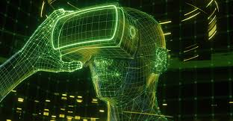
Whether you’re a METAVERSE believer, skeptic, or somewhere in between, you should become comfortable with the fact that it is too early to know exactly what a “day in the life” might look and feel like when the METAVERSE arrives
NOW WE HAVE TO DEFINE WHAT IS METAVERSE???

Slide 10
DEFINITION
“Metaverse Is a collection of 3D virtual world built using BLOCKCHAIN Technology . METAVERSE is a massively scaled and Interoperable network It can be experienced persistently by an effectively unlimited number of user with an individual sense of presence”
The Metaverse is one of the most exciting landscapes in the new world of web3
A Non-fungible token(NFT) uses the technology of Blockchain to create something that is unique in the digital world . The meaning of fungible describes item …. .

Slide 11
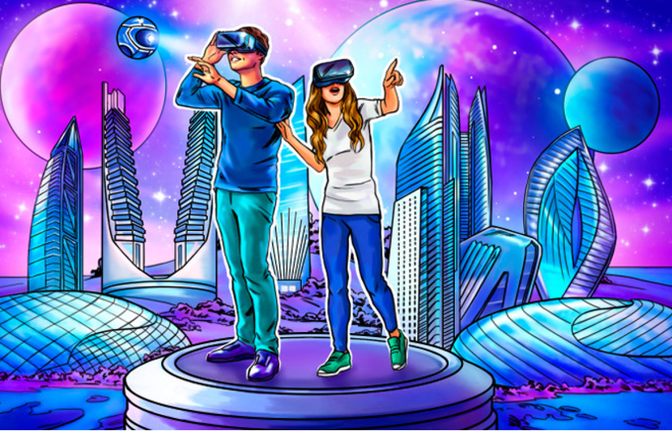

Slide 12
…. that are the exact equal value and interchangeable with each other.
For Example: One Dollar is same as One Dollar.
The main thing to always remember when you think about the Metaverse is that it is not one place. It is the aggregate of the new digital spaces that people are calling the next iteration of the internet
Also we say that,
“ Metaverse is a virtual reality in which individual can communicate and transect with each other and with digital 3D Items it relates to collaborative virtual world where currency can be used to buy and sell Land , Buildings , Avatar and even Identities”

Slide 13
For decade, the primary reason to build a virtual world was for a video games such as Minecraft. Virtual world can have single or many different creators
In virtual world blockchain based games aspired to operate at close to autonomously as possible after launch
Metaverse theorist argue that 3D environment are required in order to make possible that transition of human culture and labour from the physical world to the digital one

Slide 14
THE NEXT INTERNET
The Metaverse will require the development of new standards and creation of new infrastructure, potentially require overhauls to the long-standing Internet Protocol Suite, involve the adoption of novel devices and hardware, and might even alter the balance of power between technology giants, independent developers, and end users.
The METAVERSE will require the development of new standards and creation of new infrastructure , potentially require overhauls to the long standing internet protocol Suits , involve the adoption of novel devices and hardware , and might even alter the balance of power …..

Slide 15
....technology giants independent developers , and end users
Looking past the hype and critique, Web3 and the Metaverse are shaping a new application layer for the internet.
With a new wave of Metaverse and Web3 native disruptors, the future of the internet could be shaped by a grassroots movement that directly challenges Web2-era business models.
If a Metaverse is indeed a successor to the internet , it might seem odd that its pioneers comes from the video Gaming Industry . After all , the arc of the internet thus far is quite different

Slide 16
The next internet virtual reality VR and argumented reality AR are not new concept butt will revolutionize the world within 5 years. AR enhances reality while VR helps us forget it
The Next Generation Internet (NGI) is a European Commission initiative that aims to shape the development and evolution of the Internet into an Internet of Humans. An Internet that responds to people’s fundamental needs, including trust, security, and inclusion, while reflecting the values and the norms all citizens enjoy in Europe

Slide 17
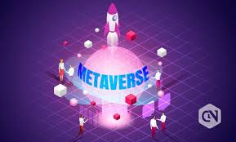
Web3.0 And METAVERSE is the insane Future of Internet

